Slide 1
SOWBARNIGA.P
Final Project

Slide 2
PLANT DISEASE RECOGNITION

Slide 3

AGENDA
Agriculture is the boon to country's Economy
Methods of detection
Machine learning Algorithms
Classification of various plant diseases
Suggest Pesticide

Slide 4
PROBLEM STATEMENT
Agriculture crops are threatened by wide variety of plant diseases.
Plant diseases can be broadly classified according to the nature of their primary causal agent, either infectious or noninfectious.
Infectious plant diseases are caused by a pathogenic organism such as a fungus, bacterium, mycoplasma, virus, viroid, nematode, or parasitic flowering plant.

Slide 5
PROJECT OVERVIEW
Dataset Collection: Gather a diverse collection of images featuring healthy plants and various diseased conditions across multiple plant species.
Model Development: Train machine learning models, such as convolutional neural networks (CNNs), to recognize and classify plant diseases based on extracted image features.
Evaluation: Assess the performance of the trained models using metrics like accuracy, precision, and recall to ensure reliable disease recognition.
Interface Design: Create an intuitive and user-friendly interface, such as a mobile app or web platform, allowing farmers to easily upload images and receive instant disease diagnosis.
Deployment: Deploy the developed system, providing accessible tools for farmers to promptly identify plant diseases, enabling timely interventions and better crop management.

Slide 6

WHO ARE THE END USERS?
Farmers: Farmers are the primary end users who would utilize the system to diagnose diseases affecting their crops. They can use the system to identify diseases early on, enabling them to take timely actions to prevent further spread and minimize crop losses.
Agricultural Extension Workers: Agricultural extension workers, agronomists, or crop consultants can use the system to provide guidance and support to farmers in identifying and managing plant diseases effectively.
Researchers: Researchers and scientists studying plant diseases can utilize the system for data collection, analysis, and monitoring of disease outbreaks. It can assist them in conducting epidemiological studies and developing strategies for disease management and prevention.
Crop Consultants and Advisors: Crop consultants, advisors, and other agricultural professionals can use the system to provide expert advice and recommendations to farmers regarding disease management practices, including pest control measures, fungicide applications, and crop rotation strategies.
Government Agencies and Agricultural Organizations: Government agencies, agricultural organizations, and policymakers can utilize the system to monitor disease prevalence and trends at regional or national levels. This information can aid in the formulation of agricultural policies, allocation of resources, and implementation of disease control measures.

Slide 7
YOUR SOLUTION AND ITS VALUE PROPOSITION
Early Disease Detection: By enabling early detection of plant diseases, our system empowers farmers to take timely actions to prevent further spread and mitigate crop losses. Early intervention can significantly reduce the impact of diseases on crop yields and ensure sustainable agricultural practices.
Increased Productivity: By providing accurate disease diagnosis, our system helps farmers implement targeted management strategies, such as appropriate pesticide applications or crop rotations, leading to improved crop health and higher yields.
Cost Savings: By preventing the spread of diseases and minimizing crop losses, our system helps farmers save on input costs associated with pesticides, fungicides, and other disease management measures. It also reduces the need for manual scouting and labor-intensive inspection processes.
Knowledge Empowerment: Our system equips farmers with valuable knowledge and information about plant diseases, enabling them to make informed decisions regarding crop management practices. It also provides access to expert advice and recommendations, enhancing agricultural productivity and sustainability.
Efficiency and Accessibility: With its user-friendly interface and real-time diagnosis capabilities, our system offers a convenient and accessible solution for farmers, agricultural extension workers, and other stakeholders involved in crop management. It streamlines the disease identification process, saving time and effort while improving overall efficiency in agricultural operations.

Slide 8
THE WOW IN YOUR SOLUTION
Real-Time Diagnosis: Our system provides instant disease diagnosis, allowing farmers to identify and respond to plant diseases in real-time. This immediate feedback enables prompt intervention, preventing further spread and minimizing crop losses.
Accuracy and Reliability: Leveraging state-of-the-art machine learning algorithms, our system delivers highly accurate disease identification results. Farmers can trust the system's reliability, ensuring precise diagnoses even in diverse environmental conditions and across multiple plant species.
User-Friendly Interface: We've prioritized user experience by designing an intuitive and accessible interface. Farmers can easily upload images of their crops, receive instant disease diagnosis, and access actionable recommendations—all through a simple, mobile-friendly application or web platform.
Empowerment Through Knowledge: Beyond just identifying diseases, our solution empowers farmers with valuable knowledge about plant diseases, their causes, and management practices. By providing educational resources and expert advice, we enable farmers to make informed decisions, improve crop management practices, and enhance overall agricultural productivity.
Scalability and Accessibility: Our solution is designed to scale seamlessly, catering to the needs of small-scale farmers as well as large agricultural enterprises. With cloud-based infrastructure and accessible mobile interfaces, our system ensures widespread adoption and accessibility, reaching farmers in remote areas and developing regions.
8

Slide 9
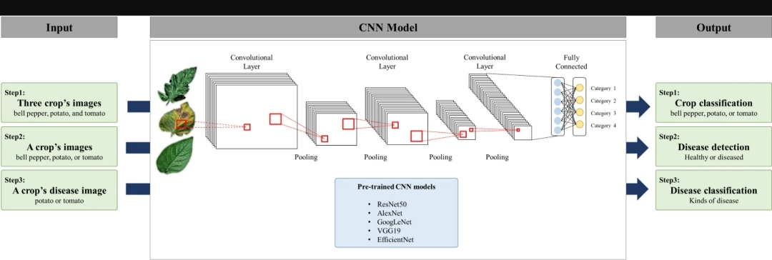
MODELLING
For the disease detection model used healthy images and diseased images for this model training and validation and cnn showed the highest accuracy in the test
The accuracy of efficient net ,googlenet,resnet50 and alexnet were follows
The test performed on cnn showed thw highest accuracy with 100% and precision and recall,and f1 score were 100%
9

Slide 10
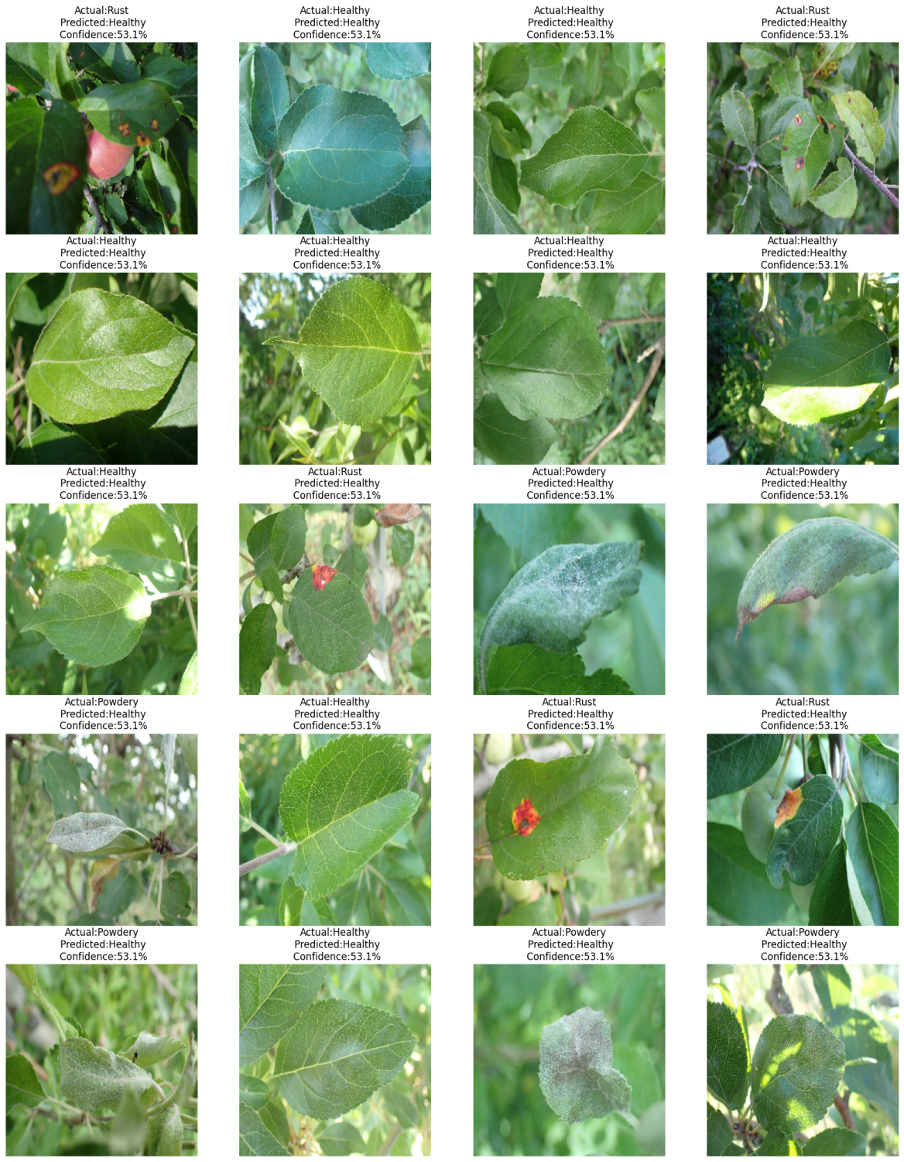
RESULTS
Accuracy: The percentage of correctly classified images out of the total number of images in the dataset.
Precision: The ratio of correctly identified diseased plants to the total number of plants identified as diseased by the model.
Recall (Sensitivity): The ratio of correctly identified diseased plants to the total number of diseased plants in the dataset.
F1 Score: The harmonic mean of precision and recall, providing a balanced measure of the model's performance.
10

